Slide 1
Optimizations of Bilinear Reaction State Model & Second-Order Reaction through Ensemble Trajectories and Nlopt.jl
Tye Phoenix

Slide 2
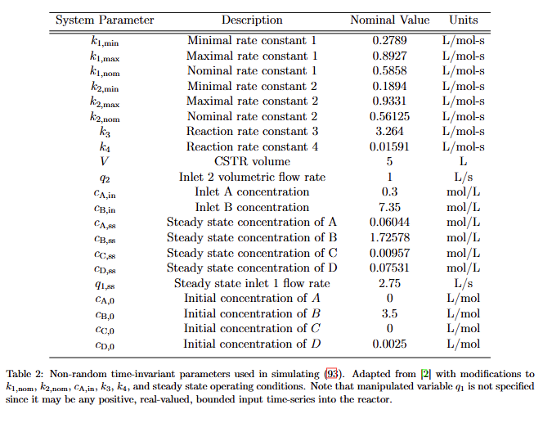
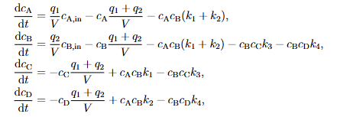
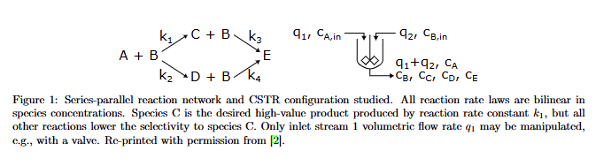
Bilinear Reaction Model

Slide 3
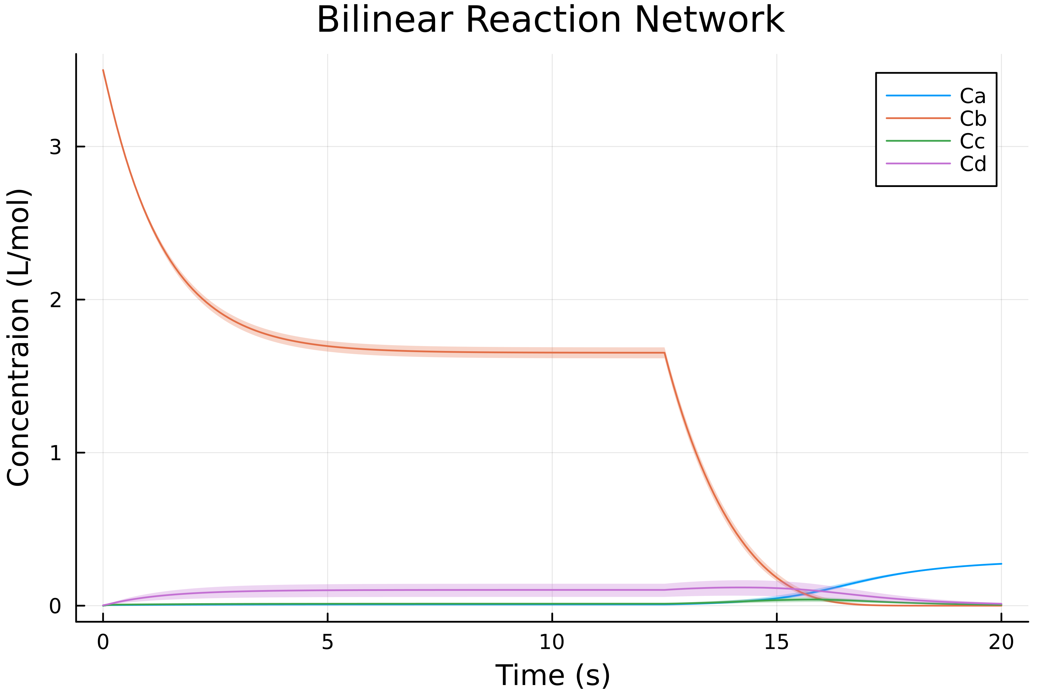
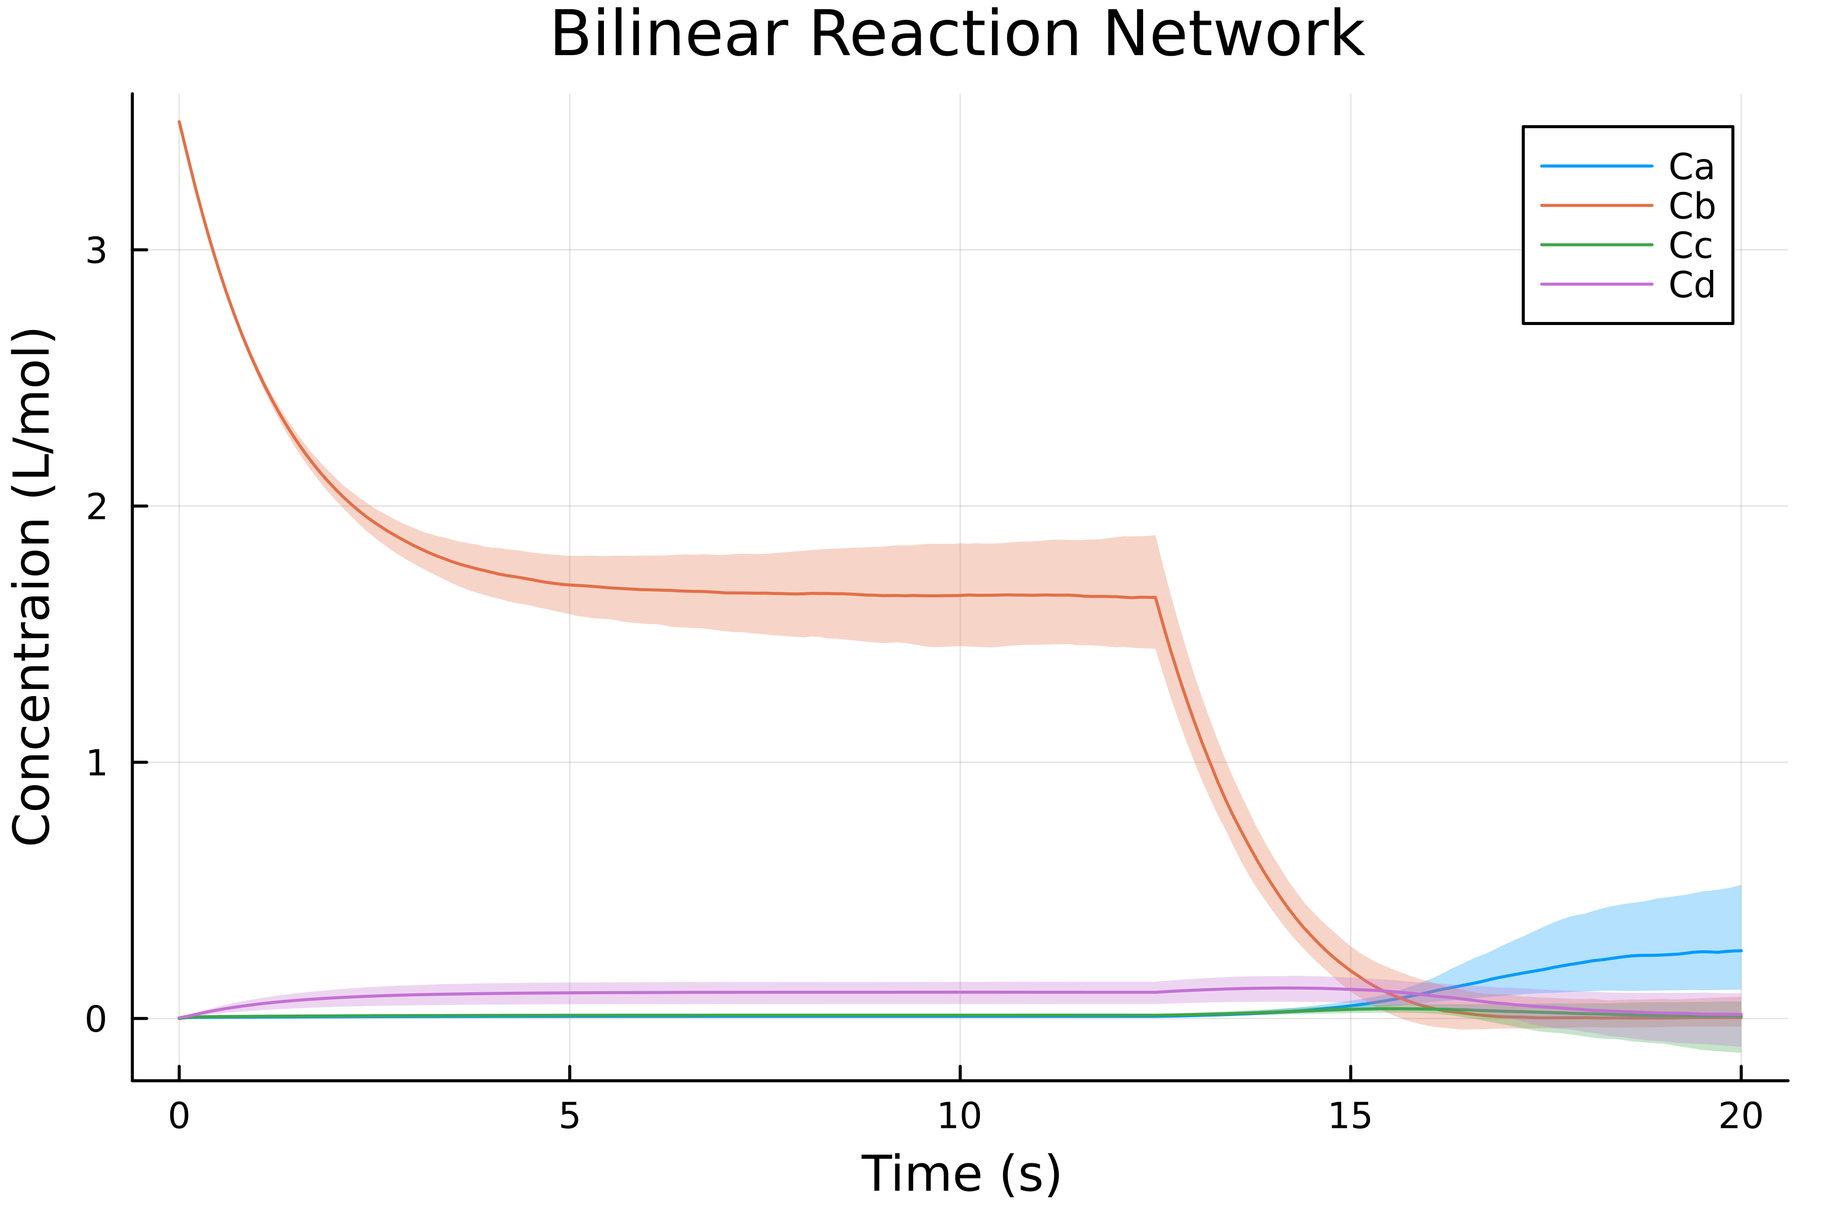
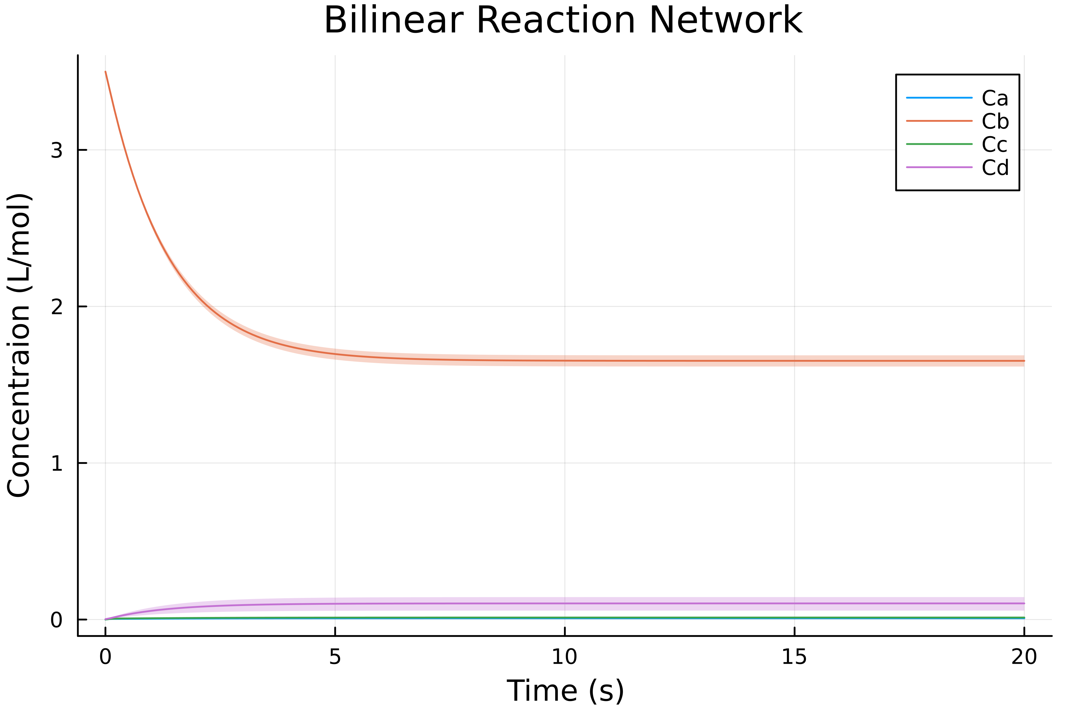
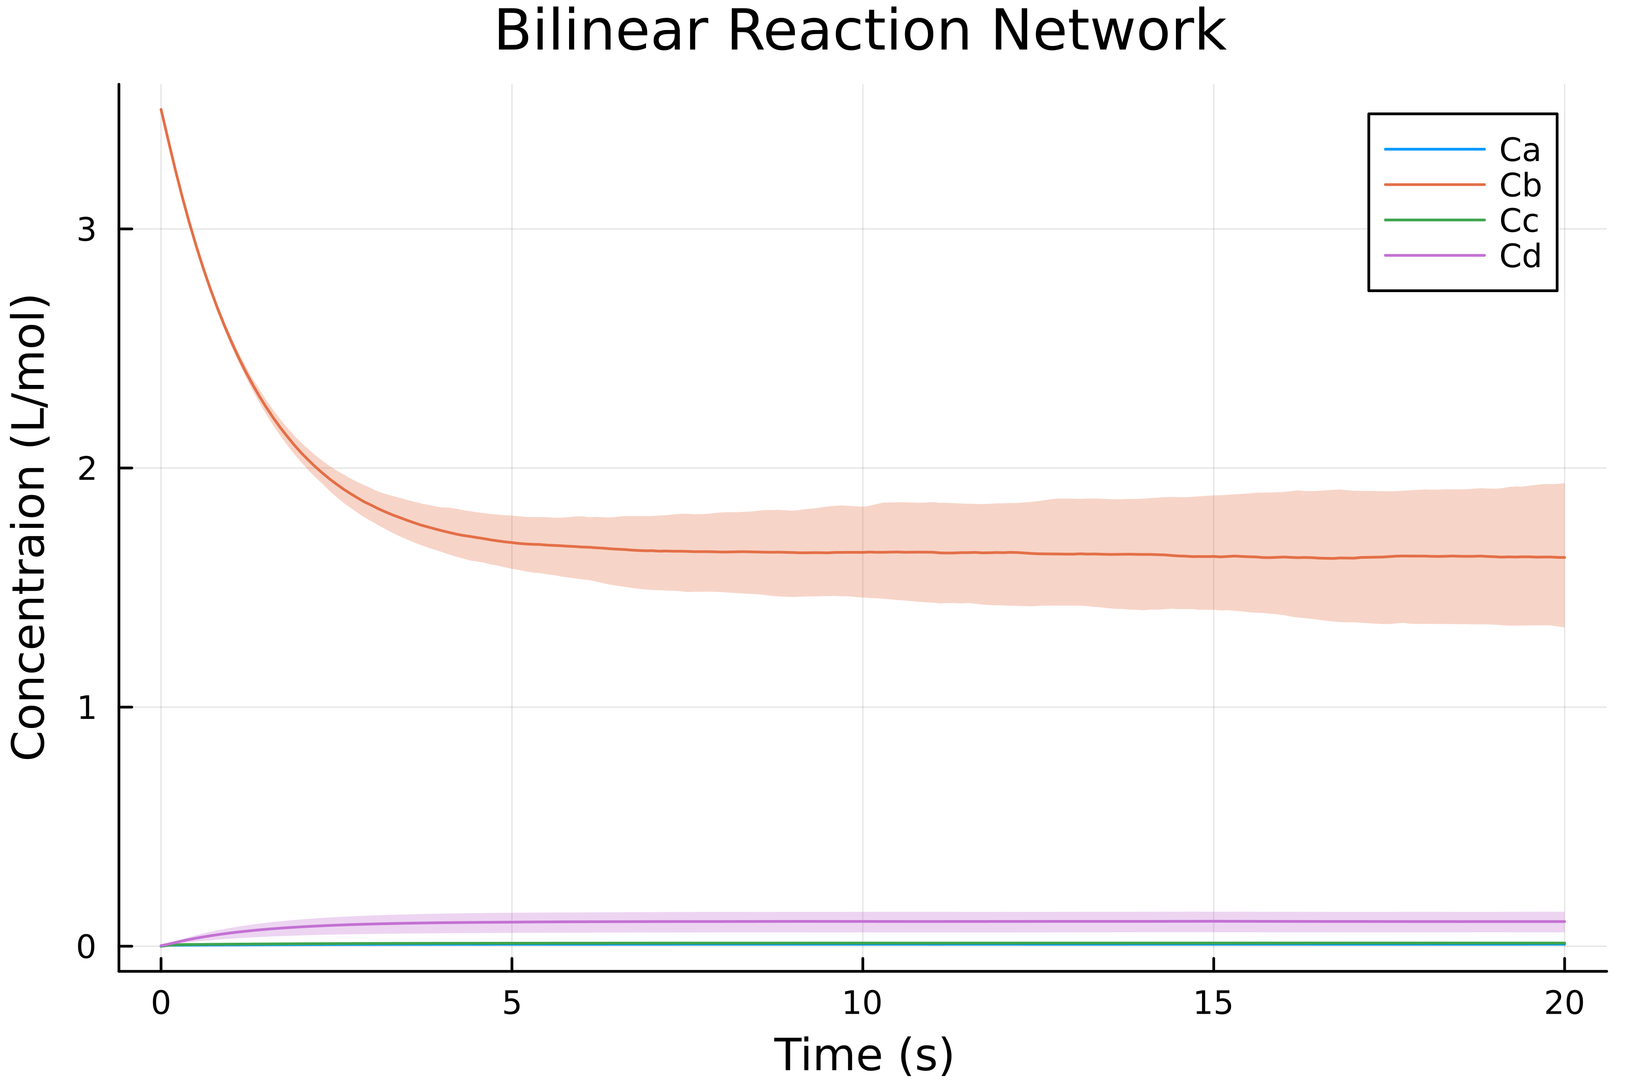
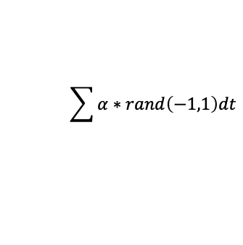
Broken Valve (2)
Both (2)
Discrete event @ t=12.5
Faulty Valve (2)
$$\sum{α∗rand\left(−1,1\right)dt}$$

Slide 4
Optimization
Found highest value at last time step in ensemble. Retrieved trajectory parameters by index.
Ca={k1: 2.789, k2: 2.265}
Cb={k1: 2.789, k2: 9.331}
Cc={k1: 8.620, k2: 2.265}
Cd={k1: 2.789, k2: 9.331}

Slide 5
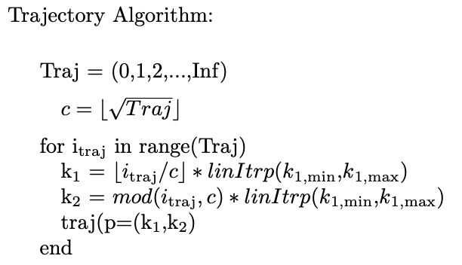
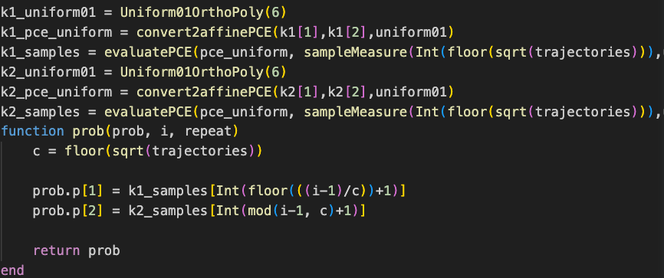
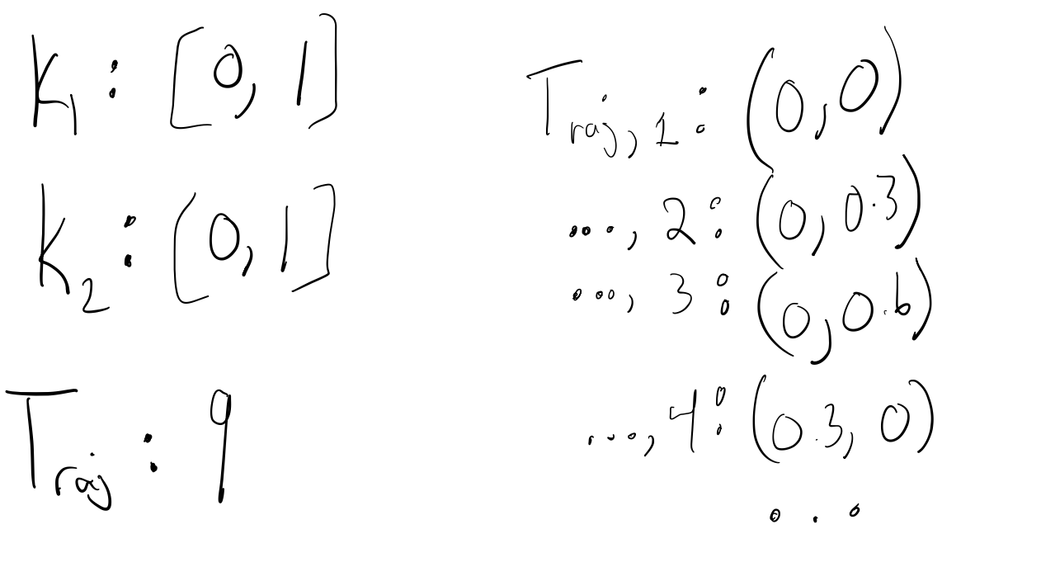
Trajectory State Machine & Maximize Algorithm through NLopt.jl

Slide 6
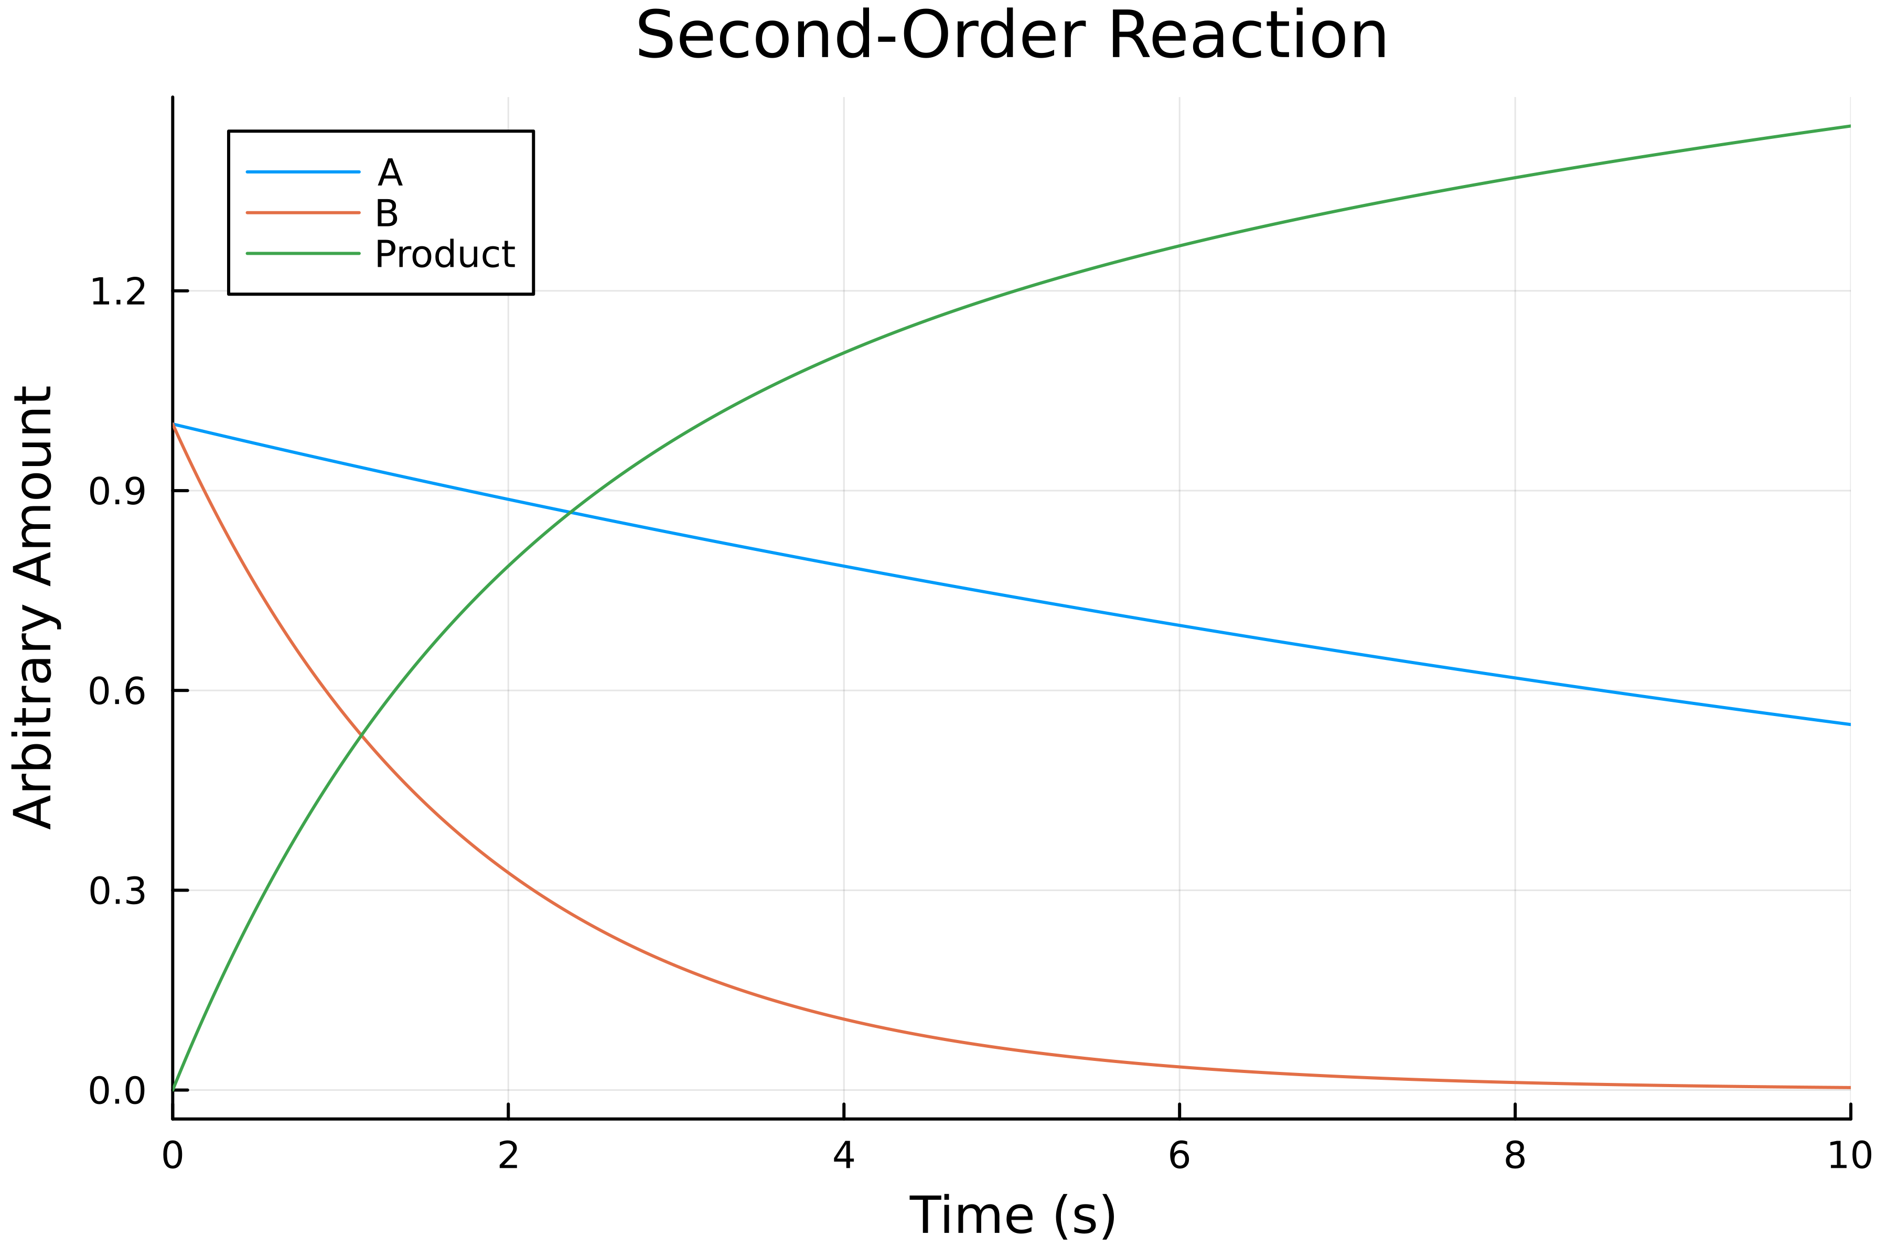
Second-Order Chemical Reaction
Variable | Definition | Value
R | Ratio of A:B to produce Product | 0.2
k | Reaction Constant | [0.1,0.9]

Slide 7
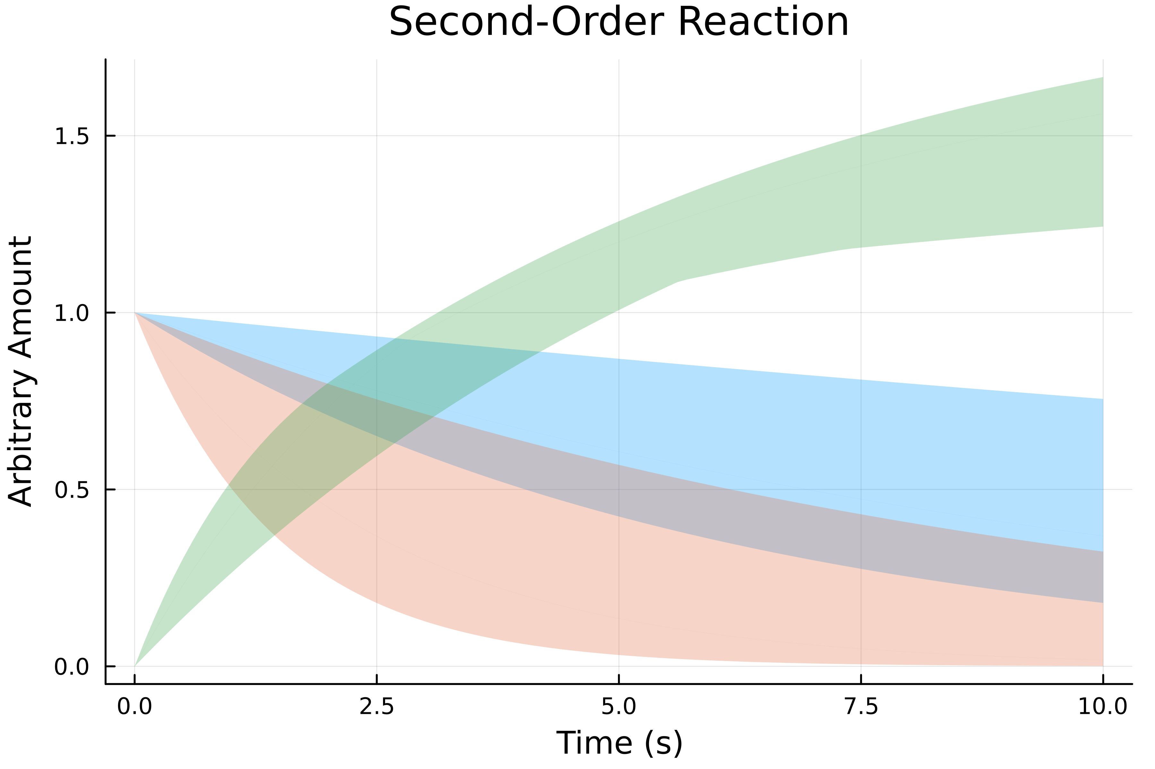
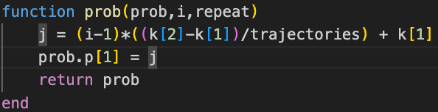
Reaction Ensemble
By plotting different trajectories due to different parameter values, we achieve an ensemble as shown below.

Slide 8
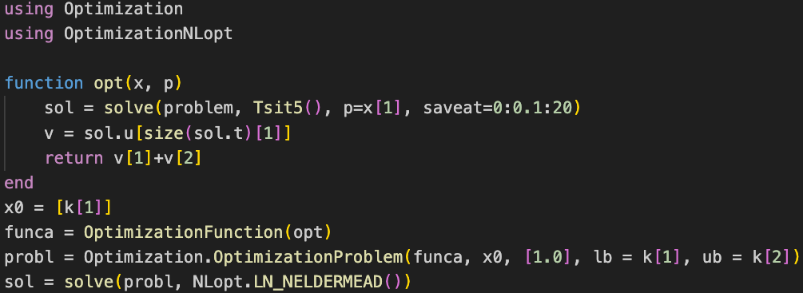
NLopt.jl Optimization
Use the solution to the ODEProblem to get the last ‘t’ value to get minimum amount of substrate at
the end of the simulation.
Returns the parameter as ’u’.
retcode: Success
u: [0.6613708585486165]
Final objective value: 0.3330058512256518

Slide 9
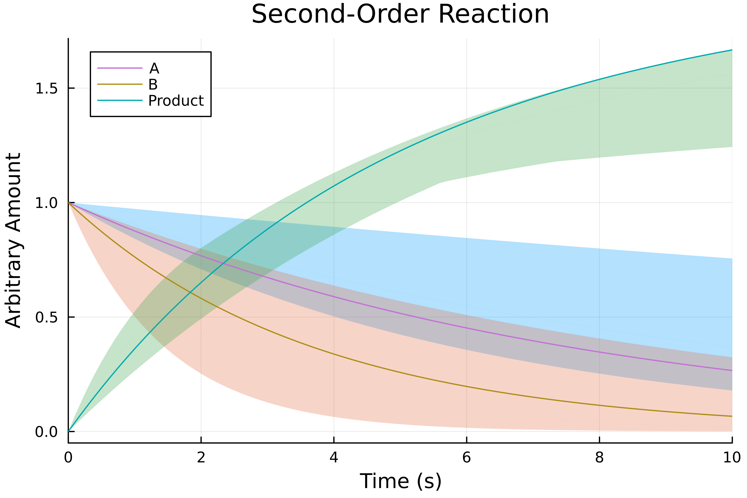
Optimization for Reaction
k ~ 0.66

Slide 10
Polynomial Chaos Sampling for Parametric Estimation
Tye Phoenix

Slide 11
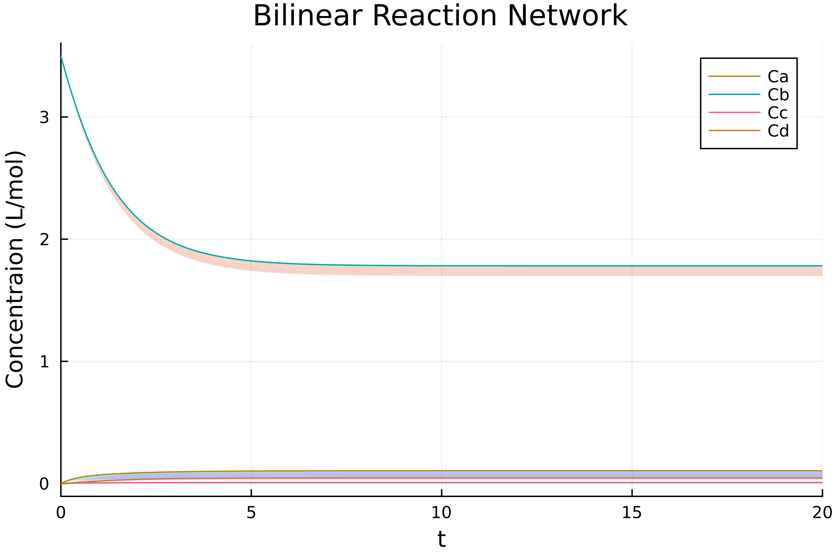
Single Tank Bilinear Reaction Network
*PolyChaos.jl’s algorithm seems to generate a randomly response? Different ensemble each iteration.

Slide 12

Second-Order Reaction
*Trajectory propagation algorithm runtime down from ~0.15 seconds to ~0.05 seconds! 3x as fast!

Slide 13
Uncertain Parameter Estimation Batch One-stage CSTR with Nlopt.jl or PolyChaos.jl
Tye Phoenix

Slide 14
Model
Given input ‘x(t)’ and output ‘y(t)’ for stochastic non-linear model, find parameters to estimate one-stage CSTR.
Configure parameters for change in time. In a real-world model, use past and current change in output to configure parameters for state model.
State estimation of ‘Batch Mode One-stage CSTR’ model provided by Krystian Ganko.

Slide 15
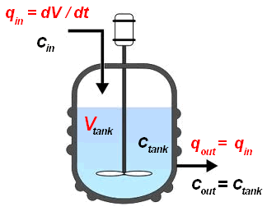
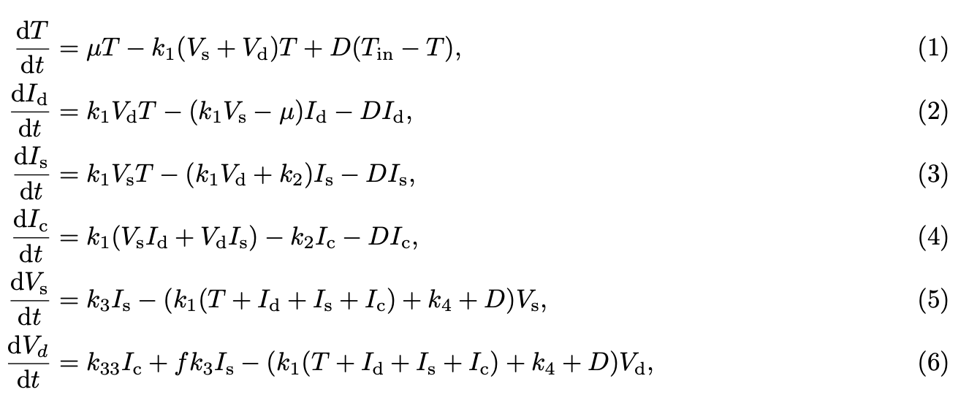
Methodology/Algorithm
Take arbitrary ‘t_{i}’ that represents a timepoint at interval where sensors are taken to see cell concentration.
Send these outputs along with inputs to digital twin to configure existing configured parameters with new data.
Configuration through error cost function passed through NLopt.jl

Slide 16
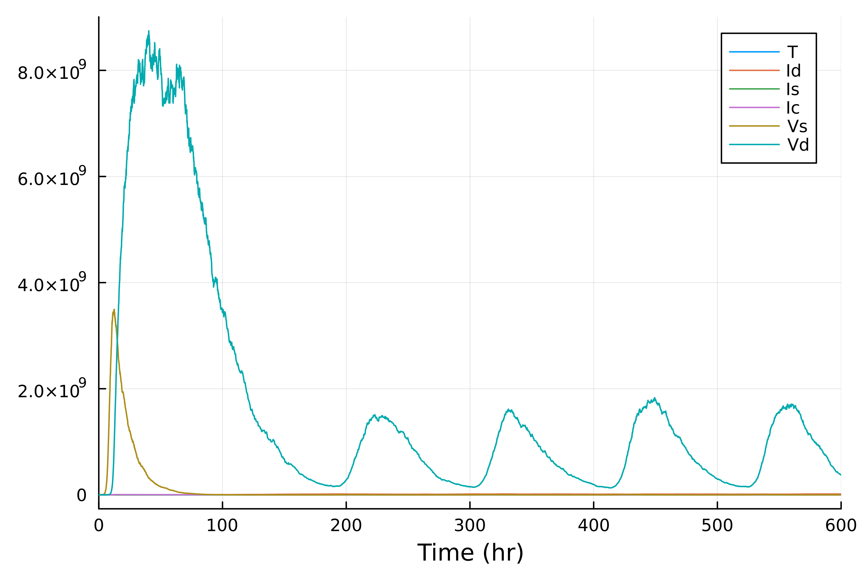
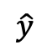
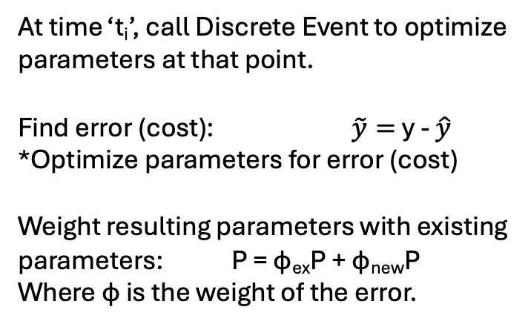
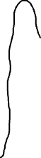
One-stage CSTR Stochastic Model
At time ‘t_{i}’, call Discrete Event to optimize parameters at that point.
Find error (cost): $\tilde{y}=$y - $\hat{y}$
*Optimize parameters for error (cost)
Weight resulting parameters with existing parameters: P = φ_{ex}P + φ_{new}P
Where φ is the weight of the error.
y
dt
$$\hat{y}$$
As t -> ∞, |(true value)-(estimated value)| approaches 0 as parameters converge.

Slide 17
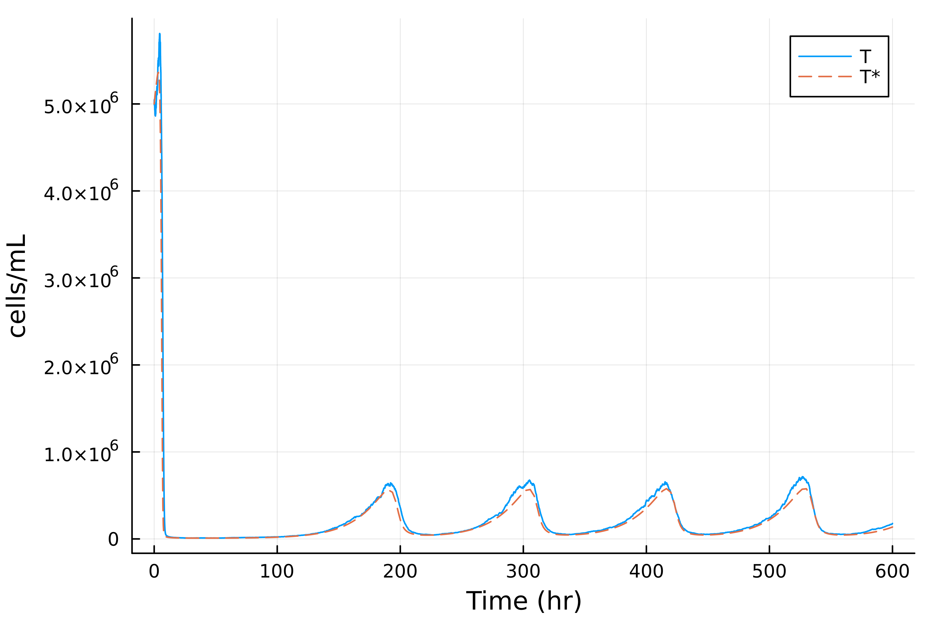
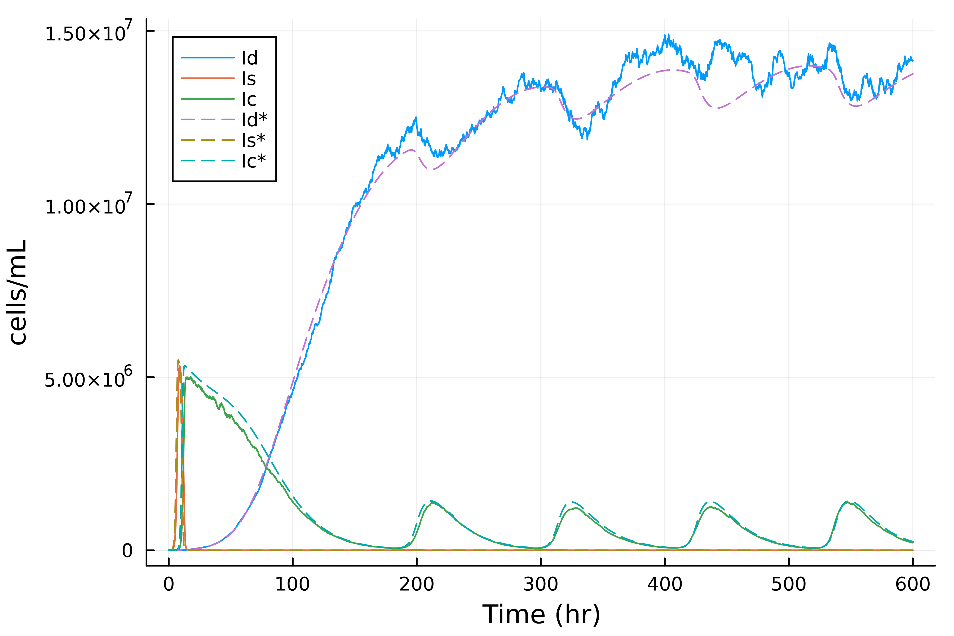
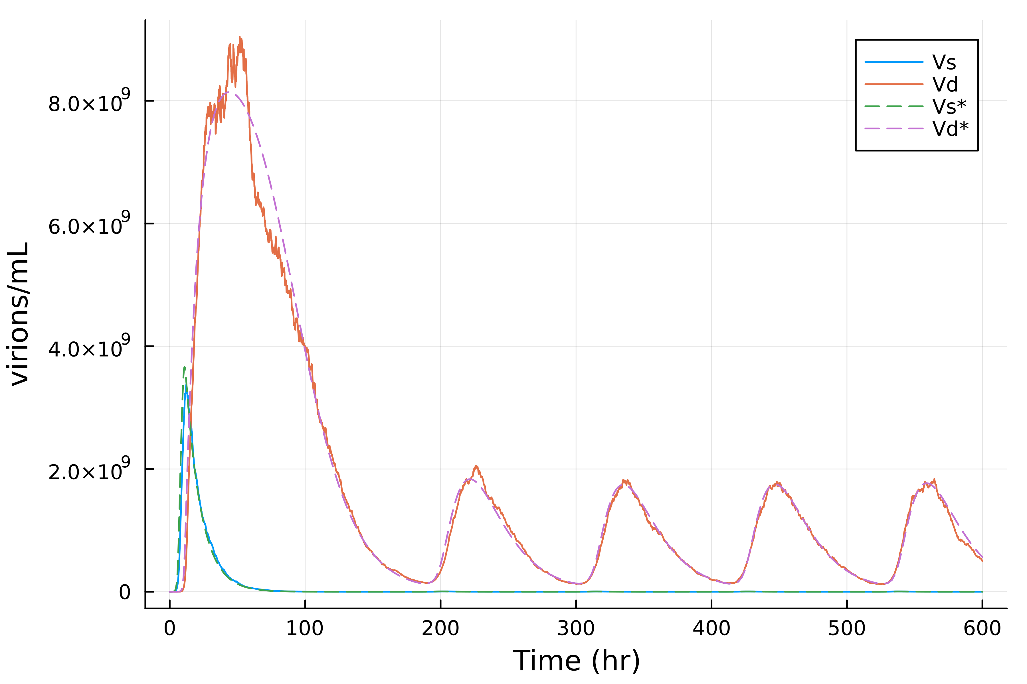
Findings for Time Span (600 hrs)
NLopt.jl
MLSL
Nelder-Mead
Configured Parameters: [2.30e-9, 0.00869, 135, 147, 0.0320, 26.2]
*Sensing interval at 50 hrs, MaxTime set to 30 seconds
*Runs in ~6 minutes
*MLSL: Multi-Level Single-Linkage

Slide 18
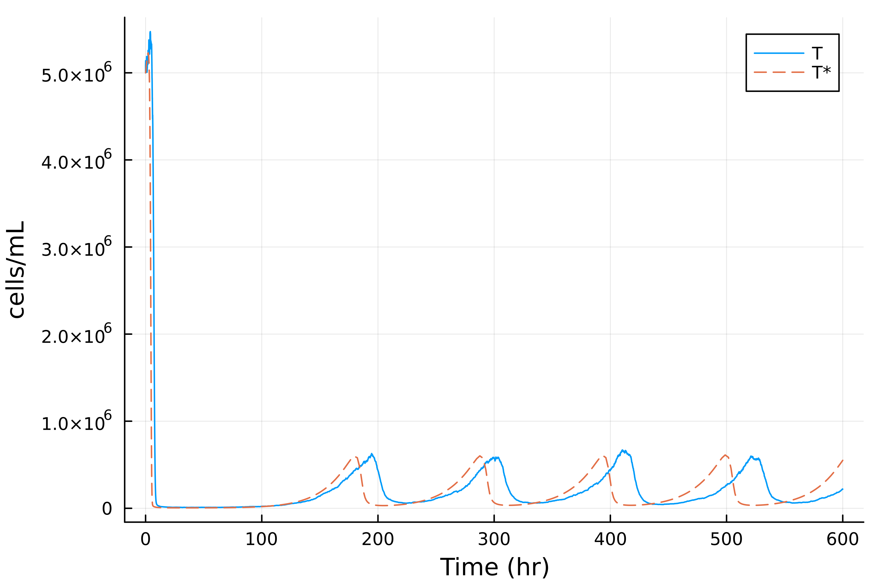
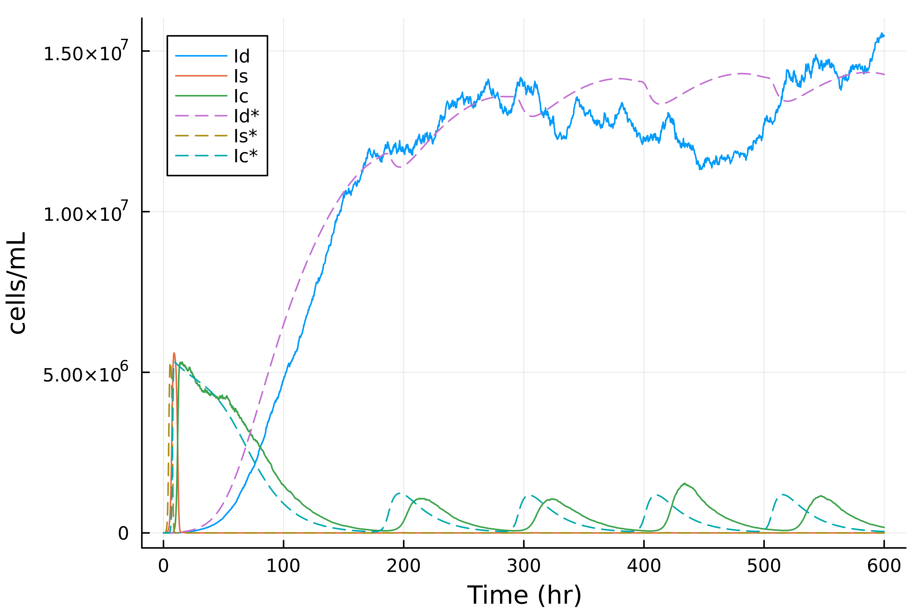
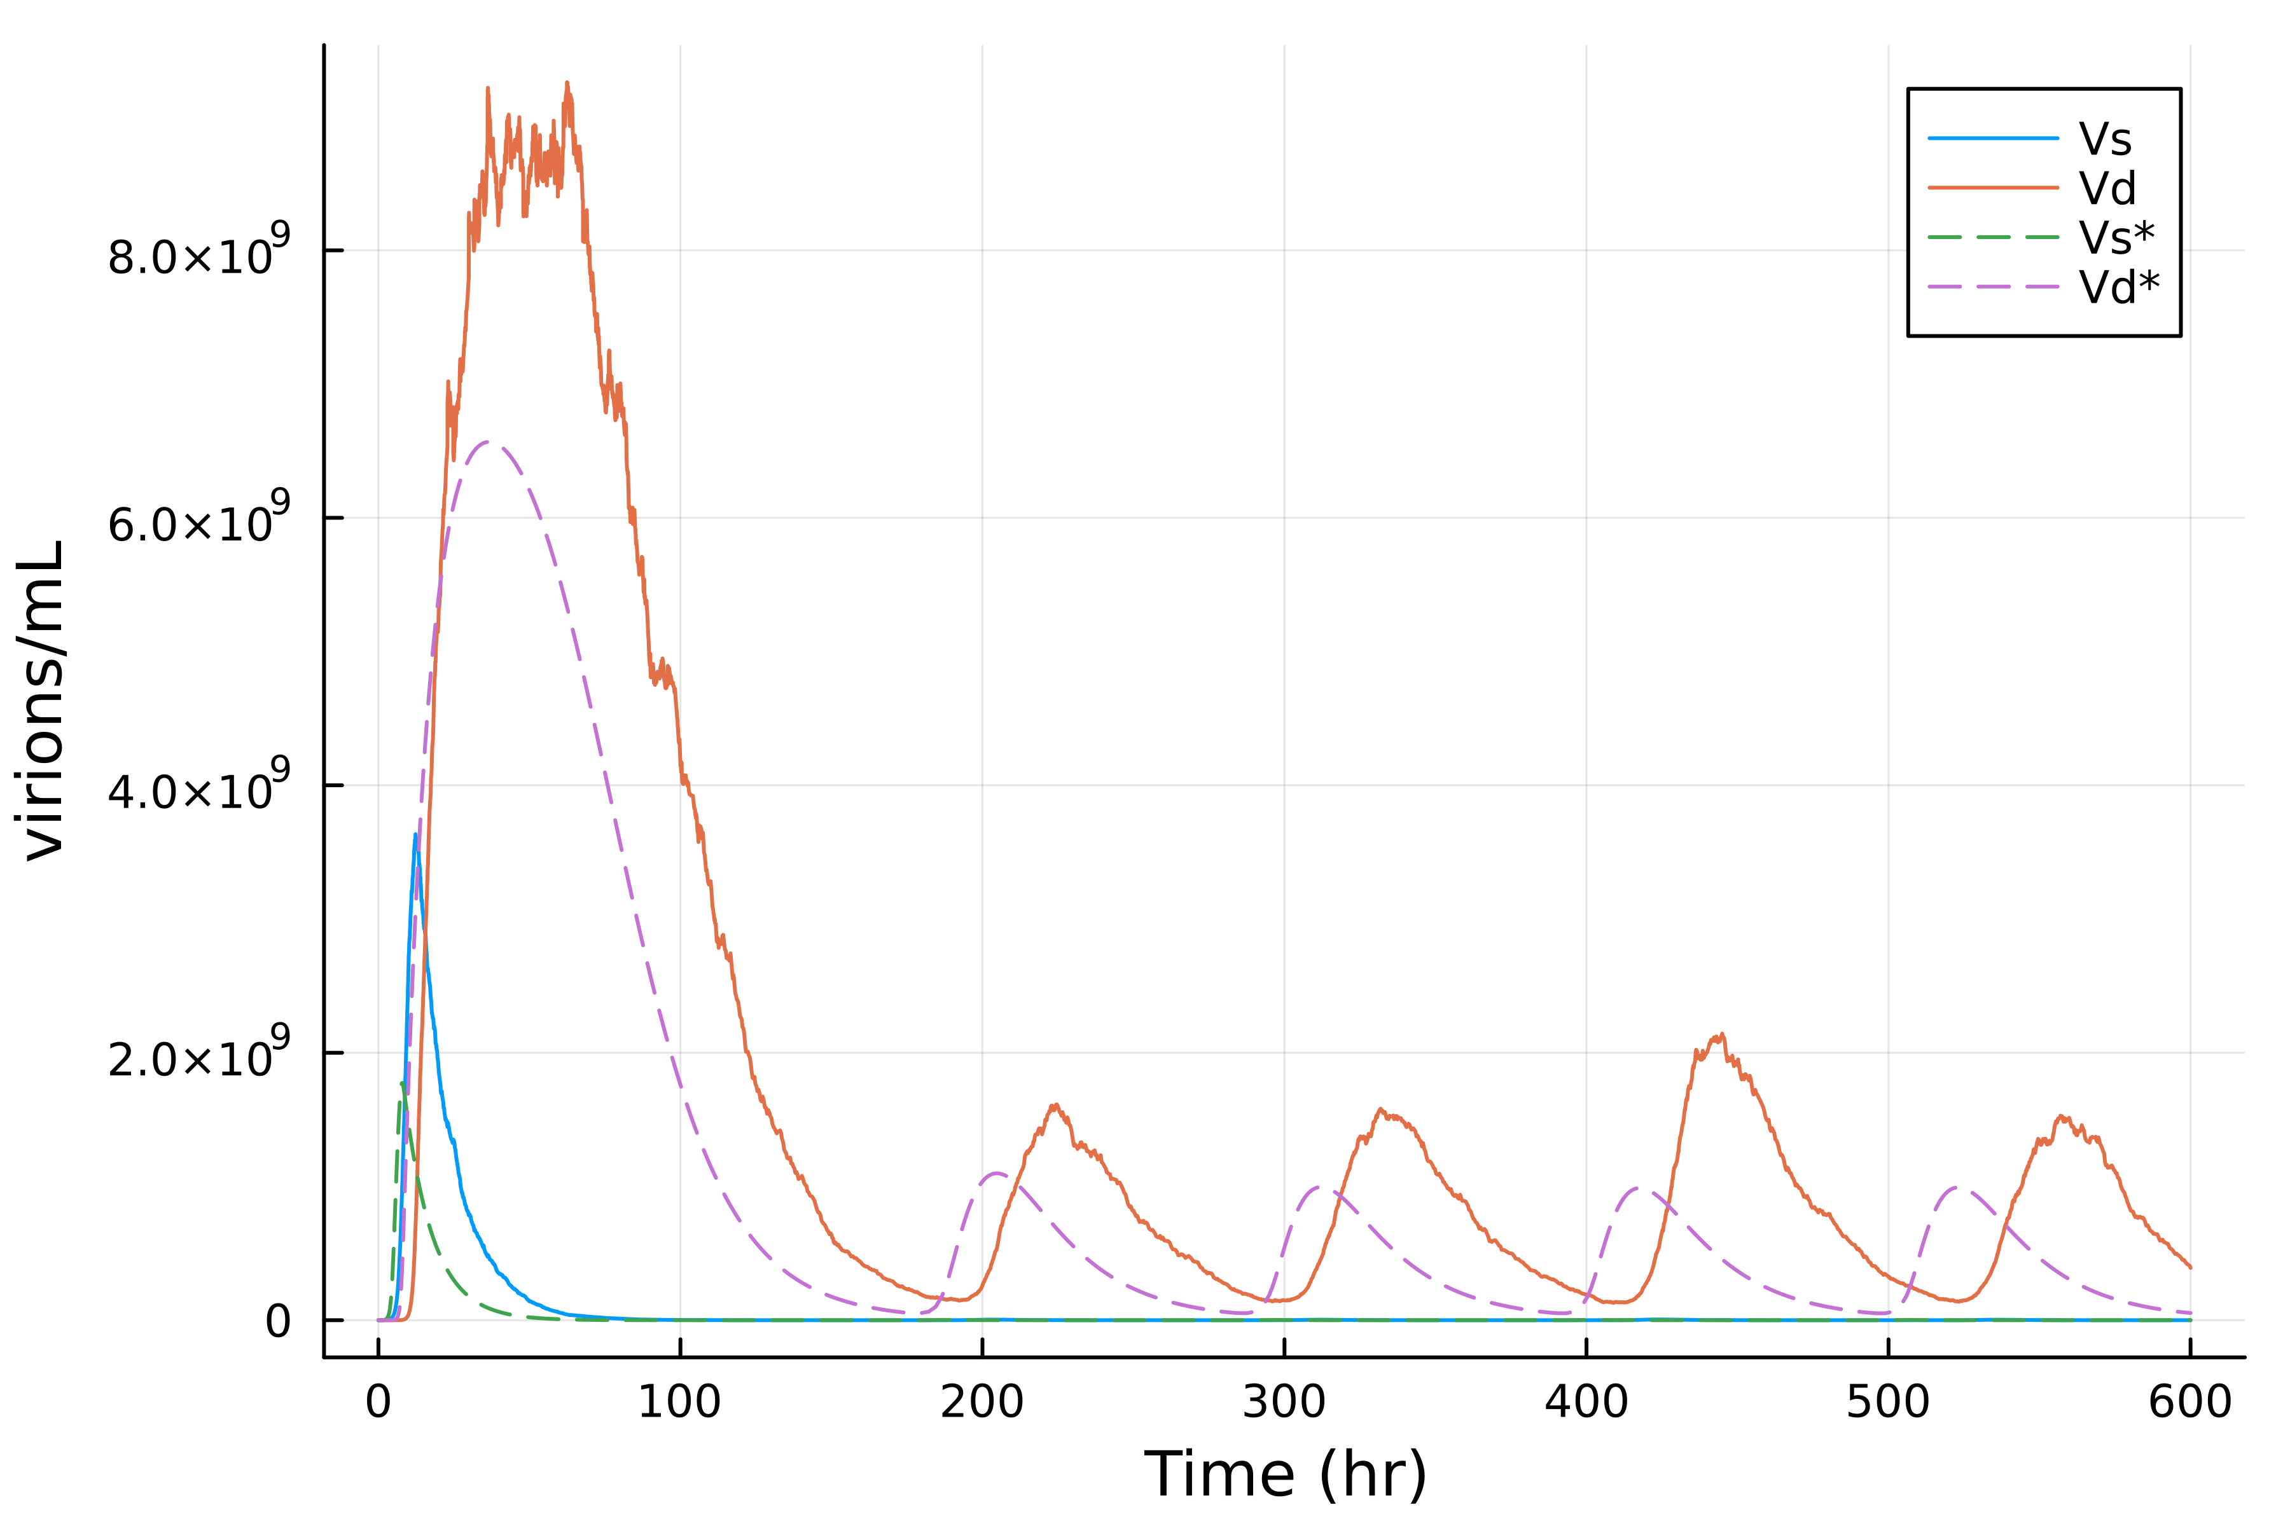
Findings for Time Span (600 hrs)
PolyChaos.jl
Configured Parameters: [5.79e-9, 0.00451, 131, 152, 0.0369, 2.31e11]
*Sensing interval at 50 hrs, d=6
*Runs in ~2 minutes

Slide 19
Bilinear Second-Order Reaction State Estimation
Tye Phoenix

Slide 20
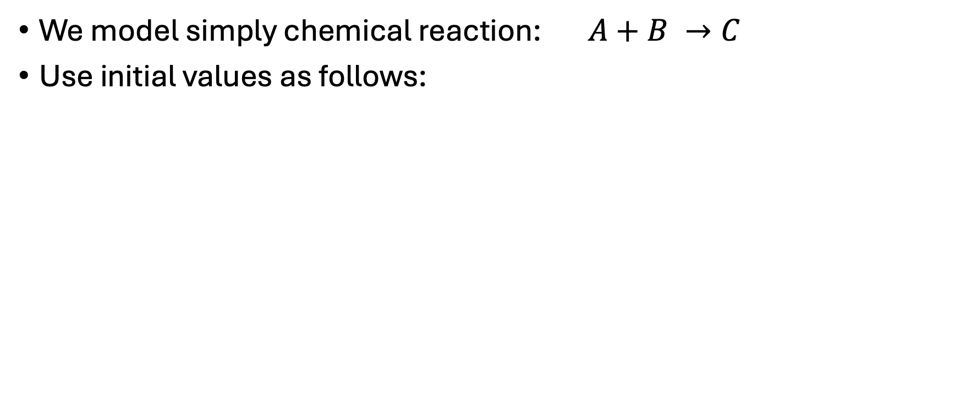
Reaction Setup
We model simply chemical reaction: $A+B →C$
Use initial values as follows:
Variable | Initial | Definition
C_{a} | 20 | Concentration of A
C_{b} | 30 | Concentration of B
C_{c} | 0 | Concentration of C
k | 0.02 | Reaction Constant
Time Span = [0,60]

Slide 21
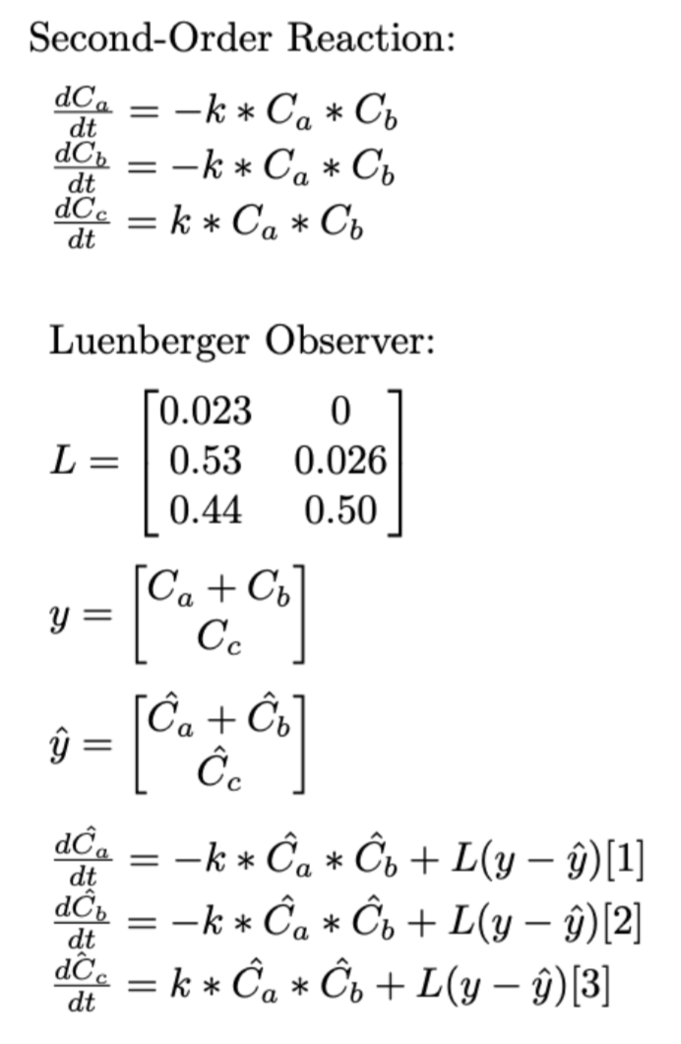
Equation Setup
Where y is the true measurements and y_hat is the estimated measurements.
L is the Luenberger Matrix with configured parameters

Slide 22
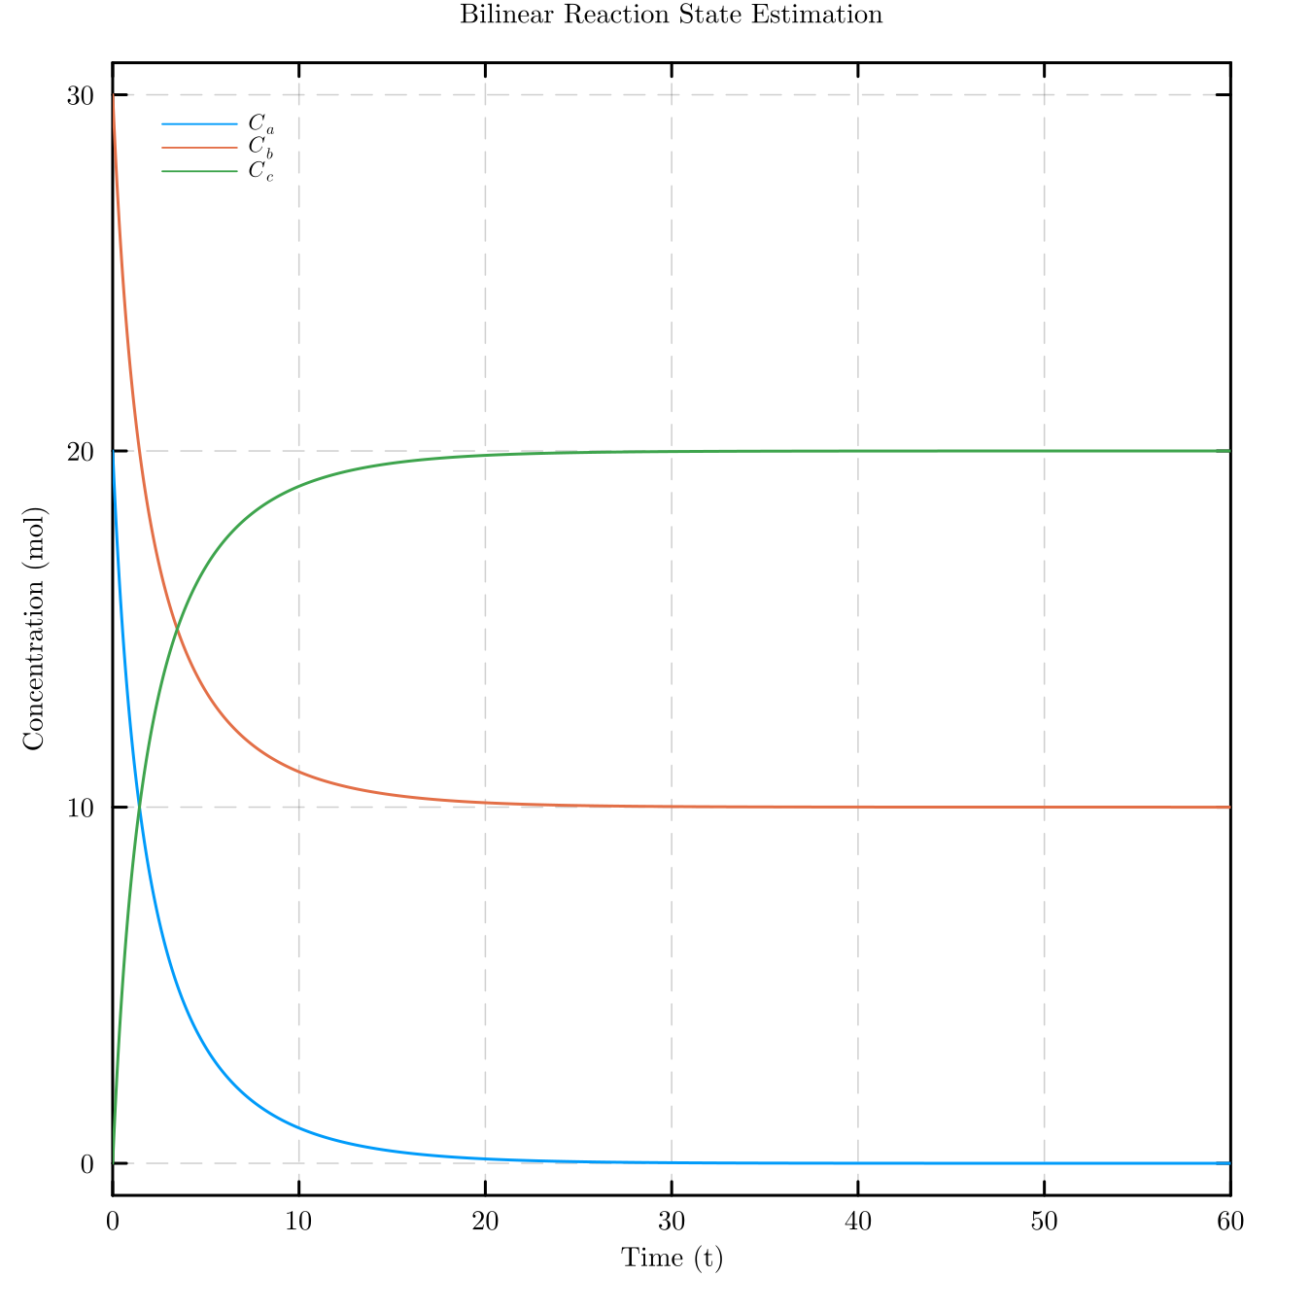
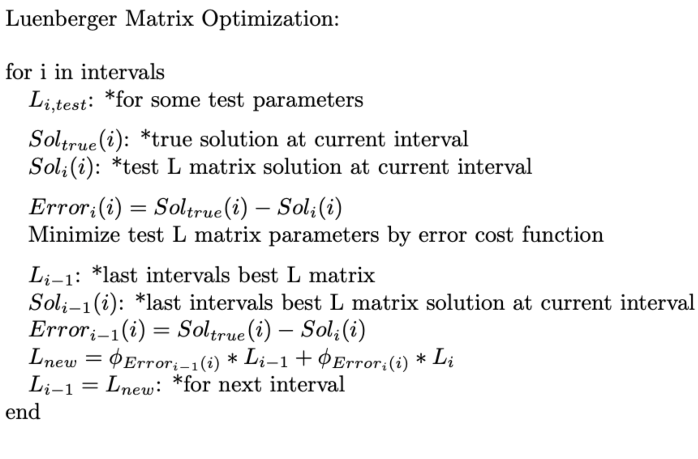
Optimizing Luenberger Matrix
Take ‘i’ intervals over time span to optimize parameters using Nelder-Mead algorithm with NLopt.jl.
i₁
i₂
i₃
i₄
i₅

Slide 23
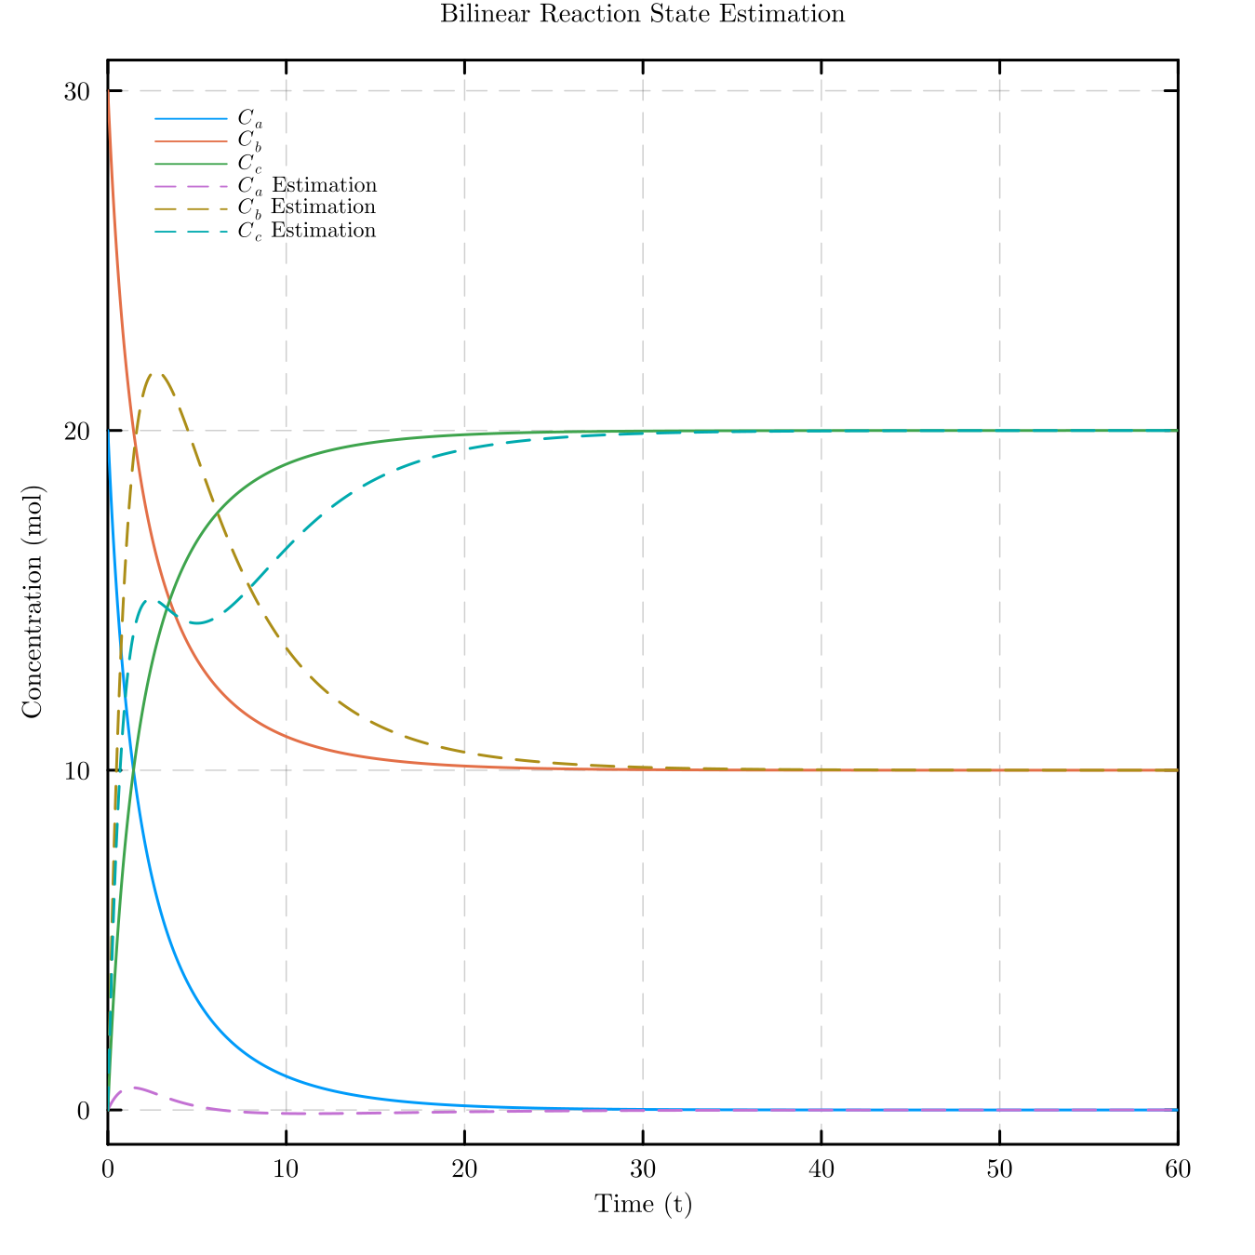
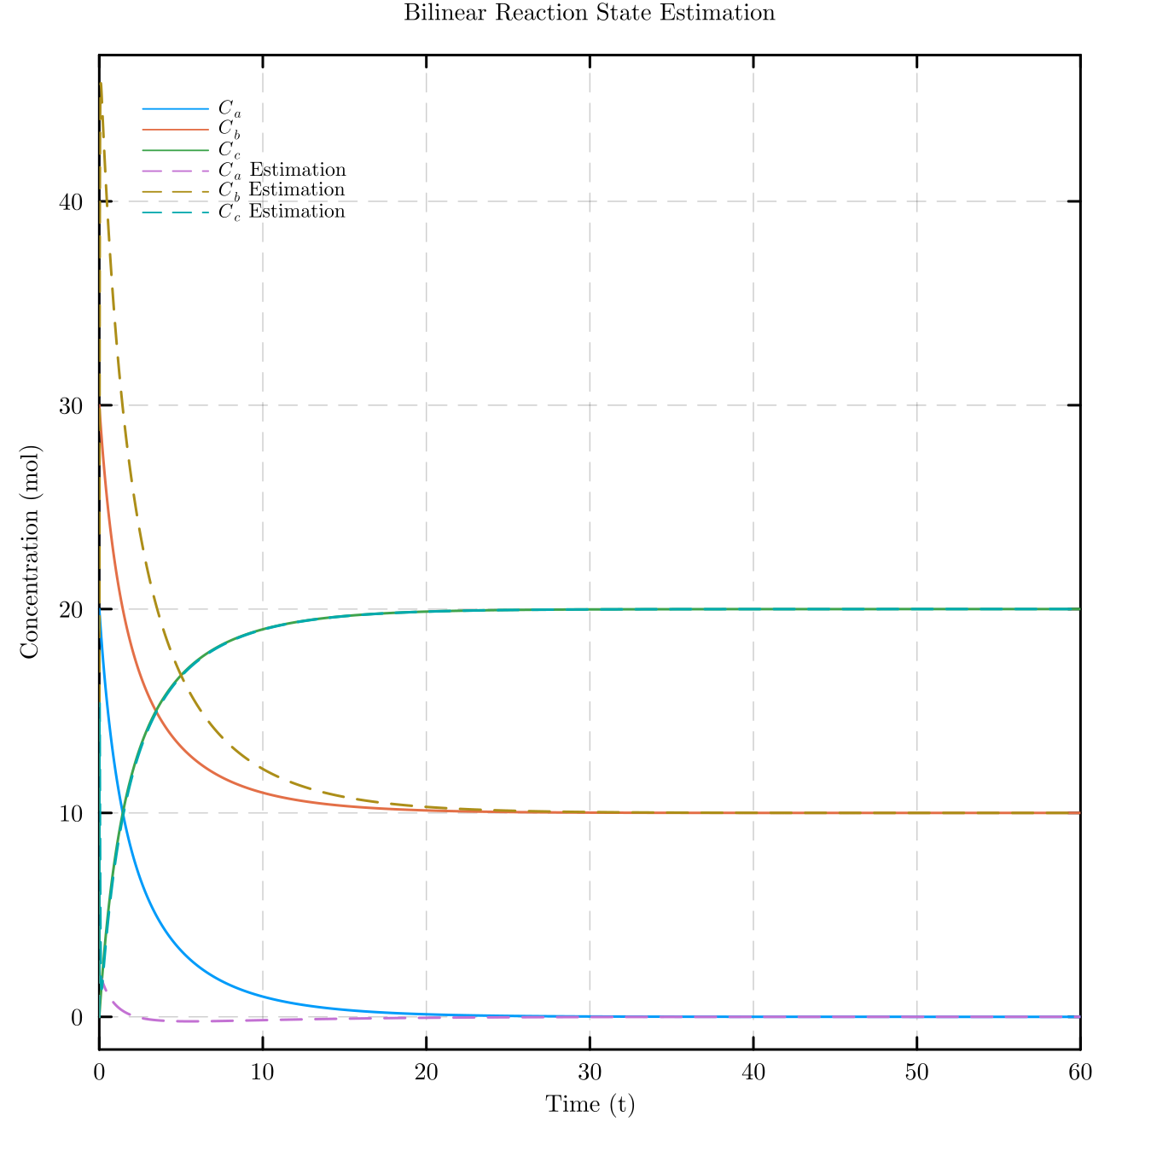
Findings
With optimized Luenberger matrix we find a solution that converges
At t = 30.
*100 x L

